Slide 1
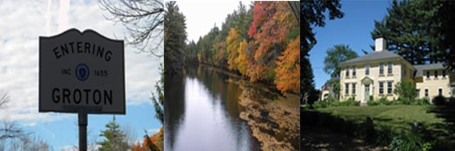
Town of Groton Economic Development Committee Plans for the Future

Slide 2
What are we going to discuss?
Current Financial Summary
Vision Statement:
Mission Statement
Revised Charge
Long Term Goals & Objectives
Goals & Objectives 2016-2017

Slide 3
Current Financial Summary
The Town of Groton is faced with increasing financial pressures to maintain both municipal and educational services.
Under our current configuration, we will likely need yearly Proposition 2 ½ overrides to close the gap between rising costs, current revenue, and flat Chapter 70 aid.

Slide 4
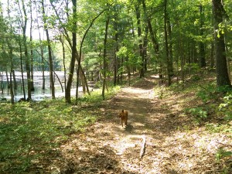
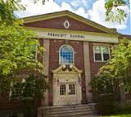
Economic Development Vision Statement
Vision:
To enhance the character, culture and commerce of Groton Massachusetts as a destination community supporting the quintessential “New England” experience through such activities as outdoor recreation, music, arts and education for the enjoyment of residents and visitors alike.

Slide 5
Economic Development Vision Statement
How:
Leverage Groton’s natural resources, and educational, agricultural, artisan, and commercial entities to attract visitors to Groton who are interested in ecotourism, as well as recreational, historic, cultural and educational activities.
Why:
In addition to recreational and cultural offerings, Groton is unique in its historical and agricultural background, geographical characteristics, and natural beauty. In addition, the opening of the new Groton Inn in 2017 and the Music Center at Indian Hill in 2020 will be transformative with respect to the economic and financial situation in Groton.
Groton will become the destination community described in our vision.!

Slide 6
Mission Statement & Charge
The Economic Development Committee (EDC) will work proactively to promote and encourage the development of Groton’s commercial tax base enhancing the quality of life in Groton. The EDC will promote, support and expand our local business community in addition to engaging new business to establish, invest and grow in Groton. An expanded business community will offer resources to town residents that will enable them to live, work and thrive in an economically forward looking and financially strong community.

Slide 7
Charge: Long Term Goals & Objectives
Growth
Education
Communication
Regulation

Slide 8
Charge: Long Term Goals & Objectives
Growth:
Identify, prioritize and develop economic opportunities and relationships that are sensitive to the intent of the master plan, the character and culture of Groton, which will make Groton an holistic and exceptional community in which residents can live, work and thrive while visitors can engage and enjoy Groton as a destination community for recreation, music, arts and education.

Slide 9
Charge: Long Term Goals & Objectives
Education:
Ensure the community, local businesses, committees and outside interested parties are easily connected to information and tools that facilitate the role and mission of the Economic Development Committee in Groton. Provide accessible information relative to past, present and future policies and other information that reinforce the importance and benefits of Economic Development and identifies Groton as being business friendly.

Slide 10
Charge: Long Term Goals & Objectives
Communication:
Provide communication plans to various audiences to promote Groton as a place to visit, enjoy and which to invest.
Regulation:
Review current regulations and/or policies through the lens of economic development, as well as facilitate and support modification of existing policies and/or development of new policies that will promote existing or new businesses to grow and stay in Groton.

Slide 11
2016-17 Targeted Focus Items
Growth:
Identify key issues that need to be resolved to achieve a sustainable economic base that would provide a vibrant local economy needed to support both the growing financial needs of the municipality, and the Groton Dunstable Regional School District.
Identify and pursue business types and locations that have the best chance of starting, growing and thriving in Groton

Slide 12
2016-17 Targeted Focus Items
Education:
Launch expanded Economic Development web presence on Town Website
Develop content for marketing materials (online/offline) on Economic Development.
Hold feedback focus group sessions with various constituent groups to understand current beliefs about Economic Development in Groton, as well as communicate our vision for the future to ensure community alignment
Develop and present recommendations to various Groton Boards and Committees on the Economic Development Committee’s economic five-year vision and plans

Slide 13
2016-17 Targeted Focus Items
Communication:
Develop communications plans to disseminate important information about the Economic Development Committee and current/future projects and development in Groton
Concept Plan issues outreach for future Town Meetings in conjunction with the Planning Board

Slide 14
2016-17 Targeted Focus Items
Regulation:
Explore, recommend and implement regulatory changes as needed
Work together with the Planning Board to support required changes in the Concept Plan
Recommend effective incentives to encourage new business development, and retain existing businesses.
Explore the possibility of offering early years property tax reduction and other incentives to encourage new businesses to come to, grow and thrive in Groton.

Slide 15
Questions?

